Slide 1

DSBA MRA Project - 1
By : Ayush Agarwal

Slide 2

Agenda
Executive Summary of the data
Exploratory Data Analysis
Market Basket Analysis
Associations Identified
Recommendation

Slide 3
Table of contents
01
02
03
Executive Summary of the data
Exploratory Analysis & Insights
Customer Segmentation using RFM analysis

Slide 4
Problem Statement
An automobile parts manufacturing company has collected data on transactions for 3 years. They do not have any in-house data science team, thus they have hired you as their consultant. Your job is to use your data science skills to find the underlying buying patterns of the customers, provide the company with suitable insights about their customers, and recommend customized marketing strategies for different segments of customers.

Slide 5

Executive Summary
Problem statement
Executive Summary & Data Dictionary
Assumptions about data

Slide 6
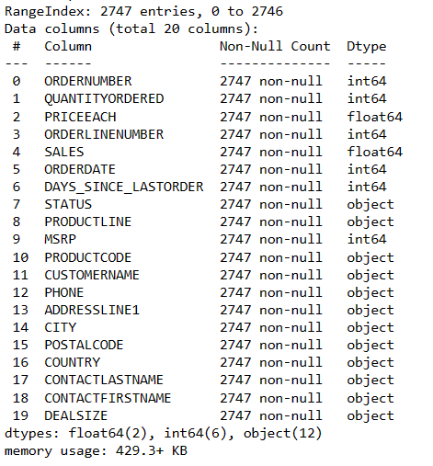
Information About the Data
Shape (2747, 20)
2747 rows and 20 columns.
No missing values.
Datatype: 2 Float datatype 6 Int datatype 12 Object datatype

Slide 7
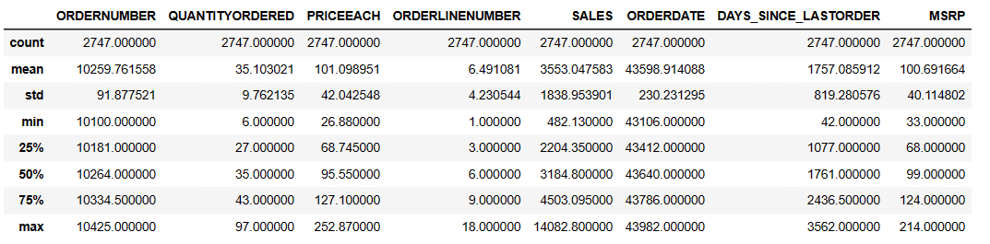
Description About the Data
On analysing the mean and median there seems to be outliers in Priceeach and Sales.
Range for each factor between max and min is high.
Count is same for all variable which indicates no null values.

Slide 8
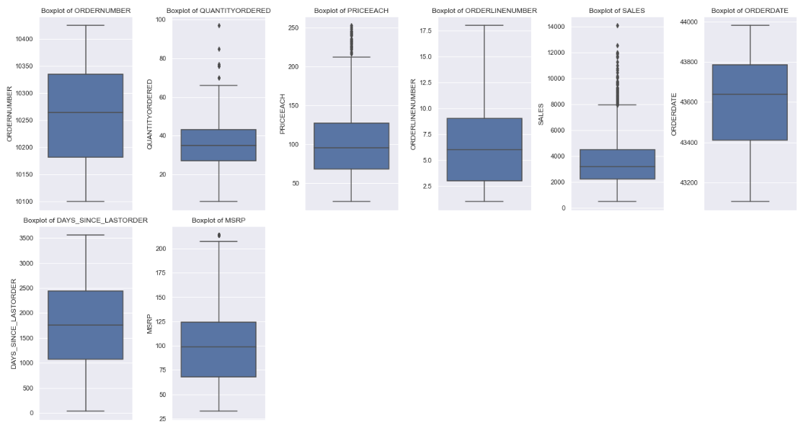
Unvariate Analysis (Numerical)
Outliers are present in 'QUANTITYORDERED', 'PRICEEACH', 'SALES', 'MSRP.

Slide 9
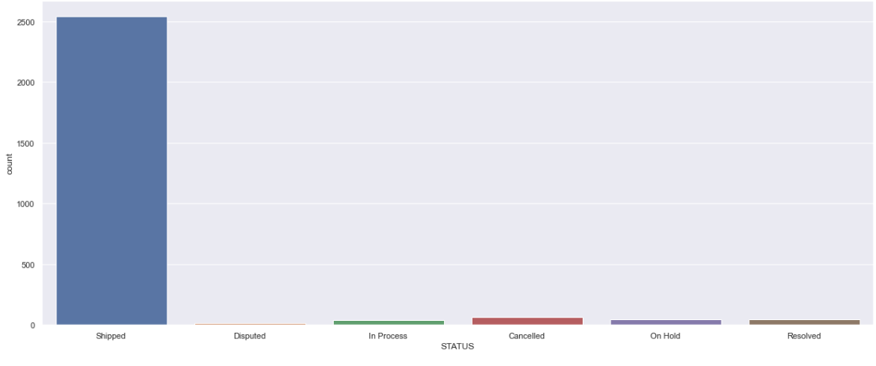
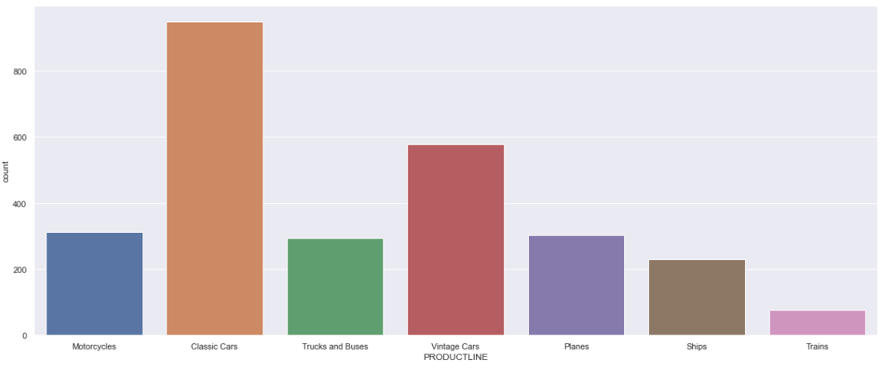
Unvariate Analysis (Object type)
Status is the highest count for shipped orders and least is for Disputed orders
Demand is highest for Classic Cars and least for Trains.

Slide 10
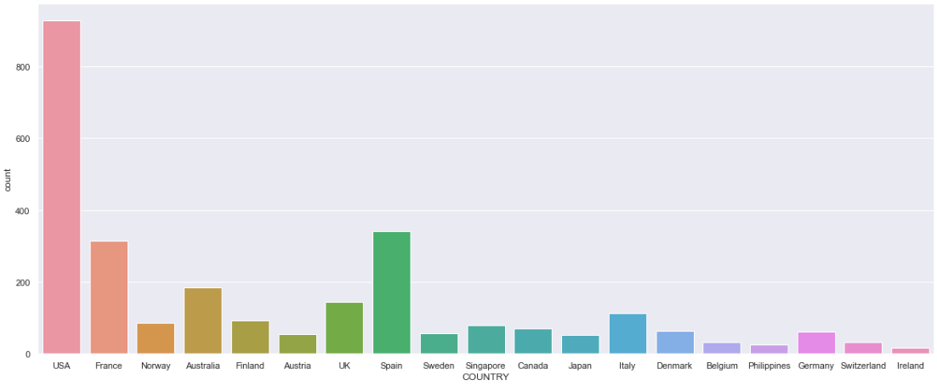
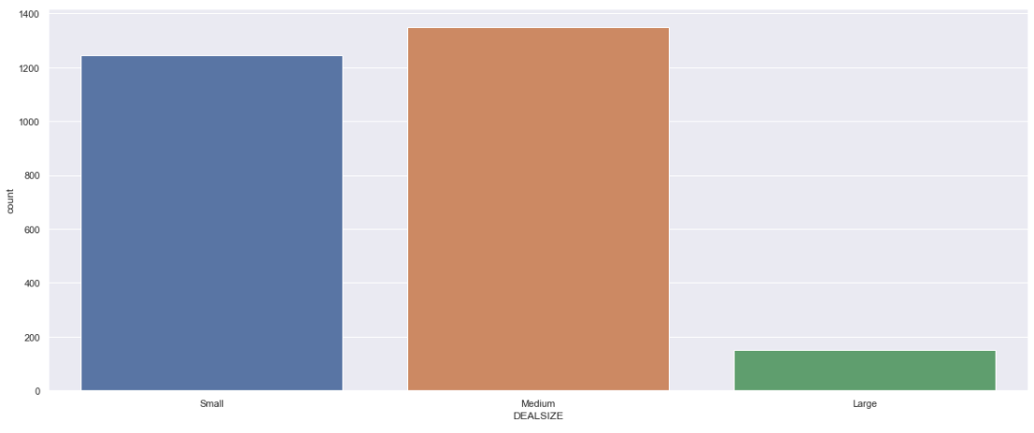
Unvariate Analysis (Object type)
Highest demand is from the country USA and the least is from Ireland.
Highest is the medium size deal and the lowest is the large size deal.

Slide 11
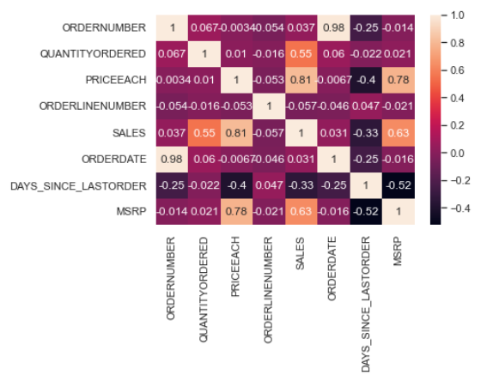
Bivariate Analysis
Positive correlation can be seen between:
SALES and QUANTITYORDERED
SALES and PRICEEACH
PRICEEACH and MSRP
SALES and MSRP
Negative correlation can be seen between:
DAYS_SINCE_LASTORDER and MSRP
DAYS_SINCE_LASTORDER and SALES
DAYS_SINCE_LASTORDER and PRICEEACH

Slide 12
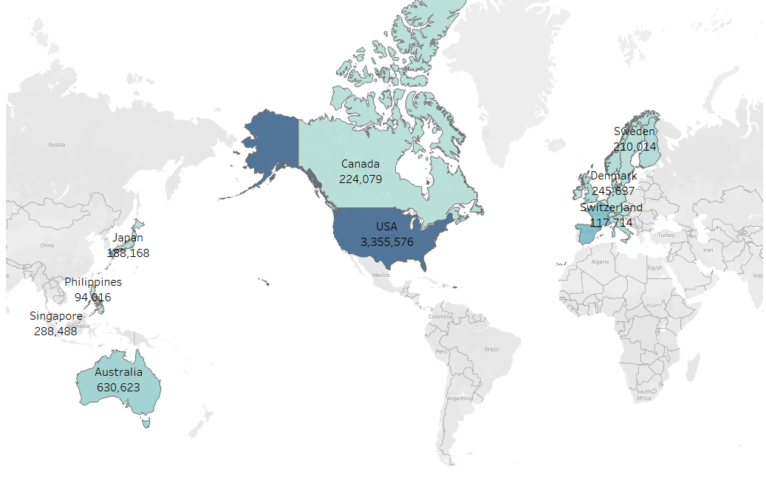
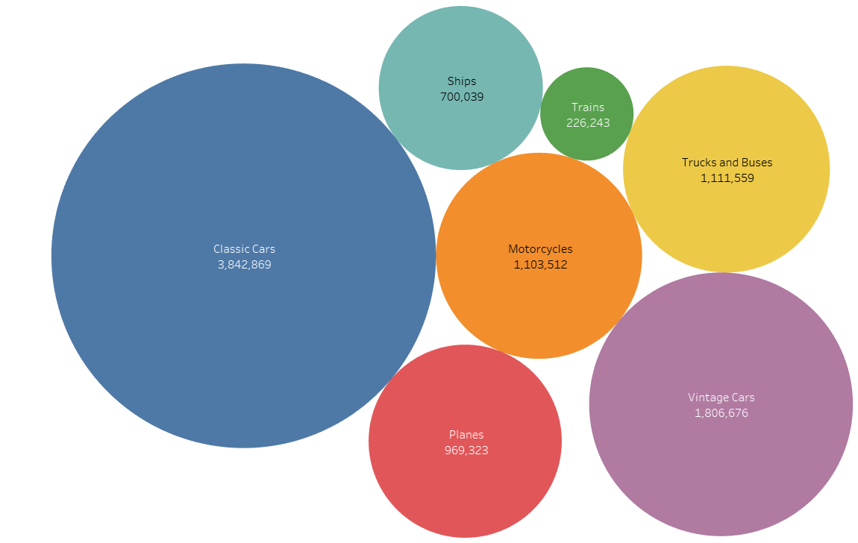
Bivariate Analysis
Sales is generated highest from USA
Sales is highest for Classic cars

Slide 13
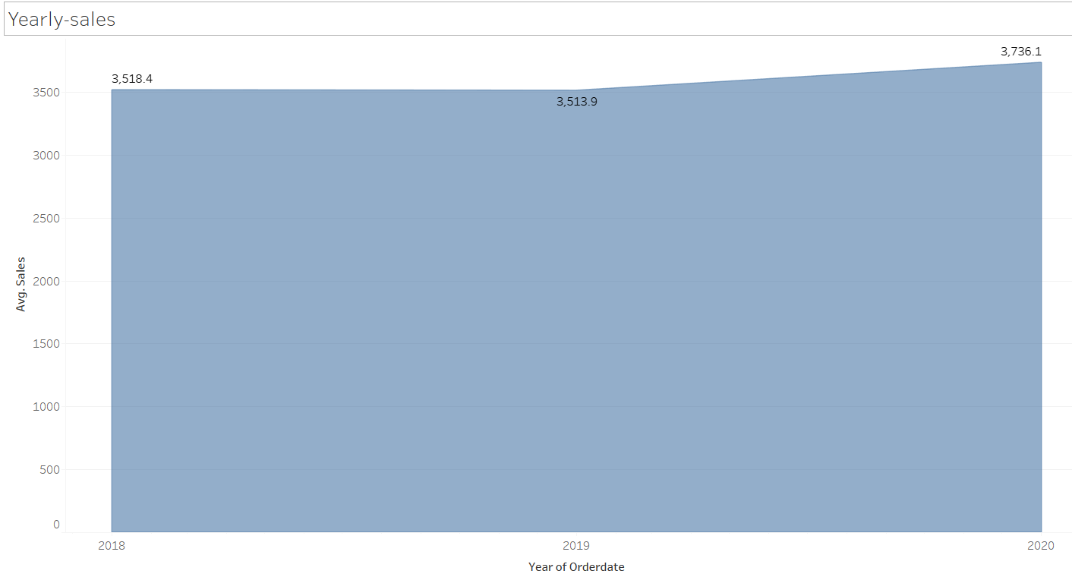
Yearly-Sales
Sales are increasing year on year.

Slide 14
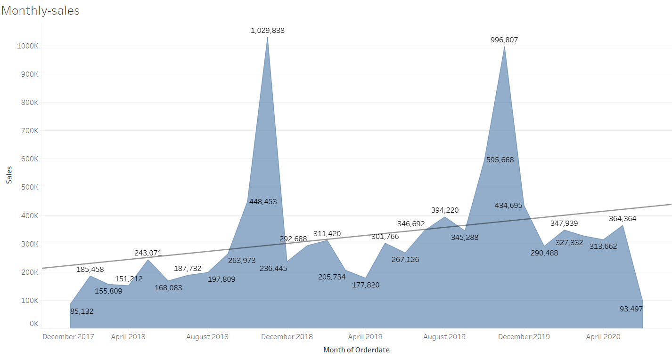
Monthly-Sales
Monthly sales peaks from September to December, and the sales are increasing year on year.

Slide 15
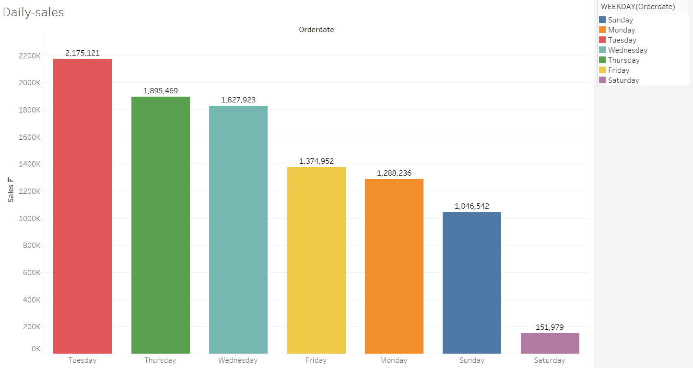
Daily-Sales
Highest sales is recorded at Tuesday and the least is recorded for Saturday.

Slide 16
Summary
Status is the highest count for shipped orders and least is for Disputed orders
Demand is highest for Classic Cars and least for Trains.
Highest demand is from the country USA and the least is from Ireland.
Highest is the medium size deal and the lowest is the large size deal.
Sales is generated highest from USA.
Sales is highest for Classic cars.
Sales are increasing year on year.
Monthly sales peaks from September to December, and the sales are increasing year on year.
Highest sales is recorded at Tuesday and the least is recorded for Saturday.

Slide 17
RFM (recency, frequency, monetary) analysis
RFM analysis is a marketing method employed to categorize and prioritize customers quantitatively, utilizing criteria like the recency, frequency, and monetary value of their recent transactions. This approach helps in identifying top-performing customers and enables businesses to design precise marketing campaigns aimed at this select group.

Slide 18

Parameters used
Revenue- Sales
Frequency- Customer Name and Orderid
Recency- Days Since Lastorder
Column 3- Recency
Column 2- Revenue
Coumn 2(right)- Frequency

Slide 19
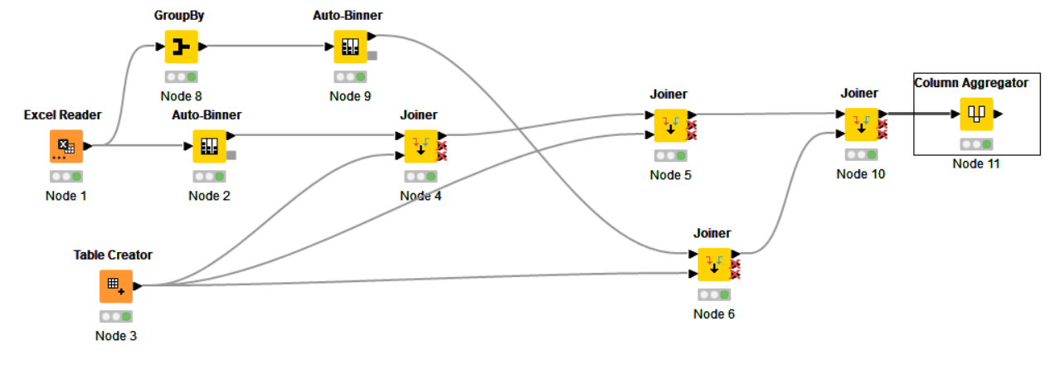
RFM KNIME Workflow

Slide 20
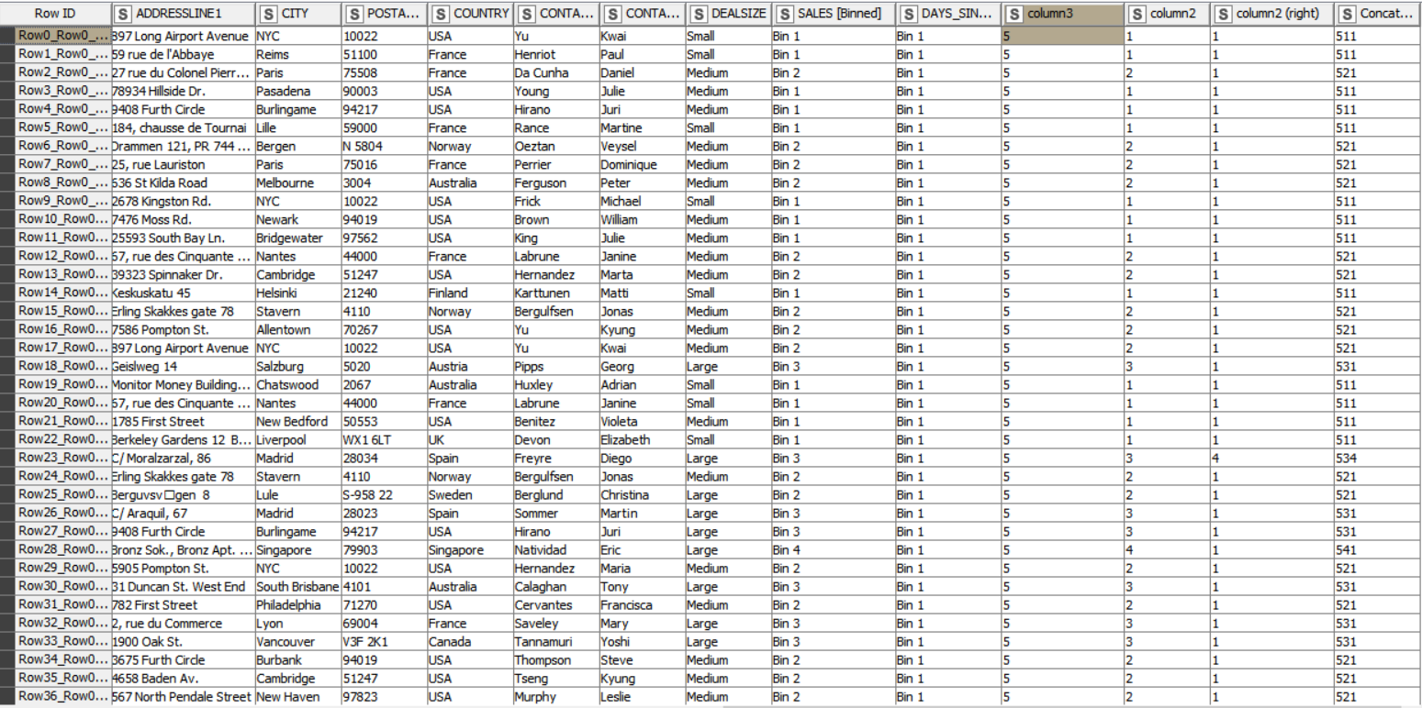
RFM KNIME Output

Slide 21
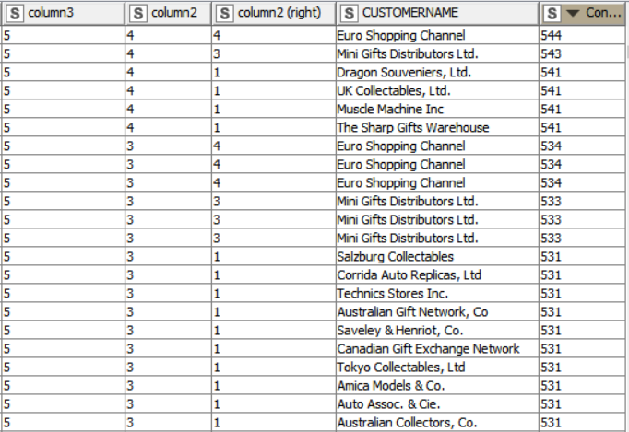
Top 5 Customers
Best Customers: Euro Shopping Channel Mini Gifts Distributor ltd Dragon Souveniers, Ltd UK Collectables Muscle Machine Inc
Loyal Customers: Euro Shopping Channel Mini Gifts Distributor ltd Land of Toys Reims Collectables Lyon Souveniers

Slide 22
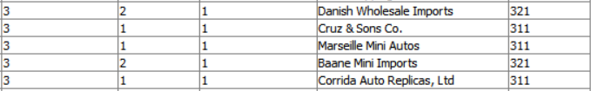
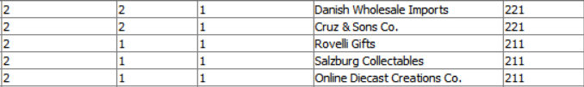
Top 5 Customers
Verge of Churning: Danish Whole Imports
Cruz & Sons Co.
Marseille Mini Autos
Baane Mini Imports
Corrida Auto Replicas, Ltd
Lost Customers: Danish Whole Imports
Cruz & Sons Co. Rovelli Gifts Salzburg Collectables Online Diecast Creations Co.

Slide 23
ThankYou

